Slide 1
Plant Moisture Sensing & Watering System
Geleta Urgessa

Slide 2
Plant Moisture Sensing & Watering System
Why this project is important?
To keep/assist houseplants alive over extended periods
Goal
To develop a system which integrates multiple sensors together in order to:
Keep Plants Alive
Able to Detect Plant Environment
Able to Detect battery level
Able to detect reservior level

Slide 3
Components
ATmega328P/Particle
LED
Relay
YL69 Moisture Sensor
Water Pump
Battery Level Sensor
1602 LCD module
Water Level Sensor
Gravity Drip Irrigation
UV Light
Notes:
Add Input and Output

Slide 4
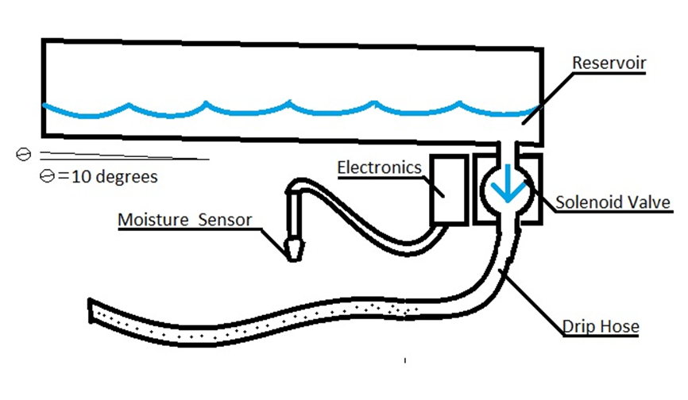
Gravity Drip Irrigation
What Is Gravity Drip Irrigation?
filter, backflow prevention
>95% efficiency
1/2" PVC Piping
PVC Rreservoir
Solenoid Valve
Drip Hose

Slide 5
Sensors
Moisture Sensor
Low Power Consumption
Uses resistance of the dirt. As the dirt gets more moist, the resistance of the dirt goes down
Water Level Sensor
Low Power Consumption
Non-corrosive leads (aluminum)
Detects resistance of the water
Different Sig+ correspond
to different water levels

Slide 6
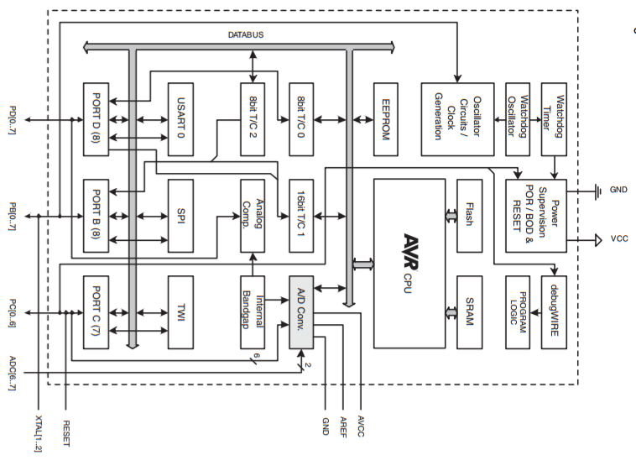
ATmega328P Block Diagram

Slide 7
System Overview
The microcontroller receives the data from the sensors
The micro controls the opening and closing of the Relay
The relay controls the pump

Slide 8

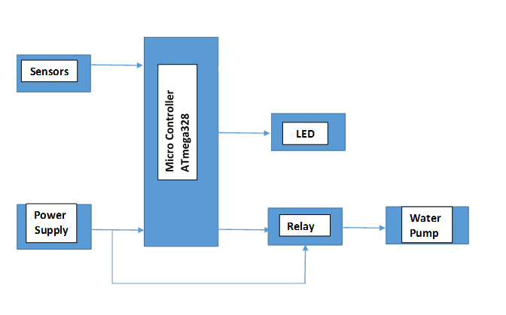

System Block Diagram

Slide 9
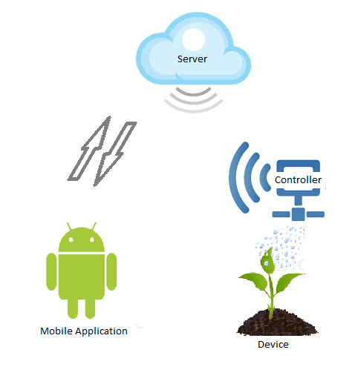
System Overview
Communicate real time sensor readings
via PC server
Store historical data
Send device notifications
Battery status
Reservoir empty
Plant moisture critical
User Input
Device settings

Slide 10

Thank you!

